Slide 1
BristleBot
Benn Thomsen

Slide 2
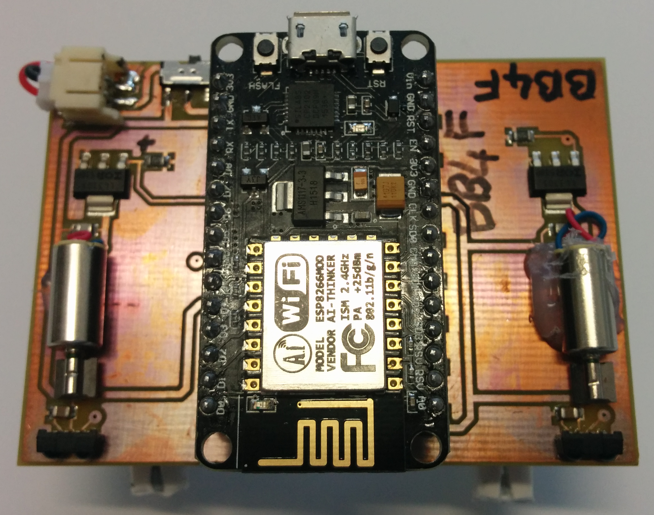
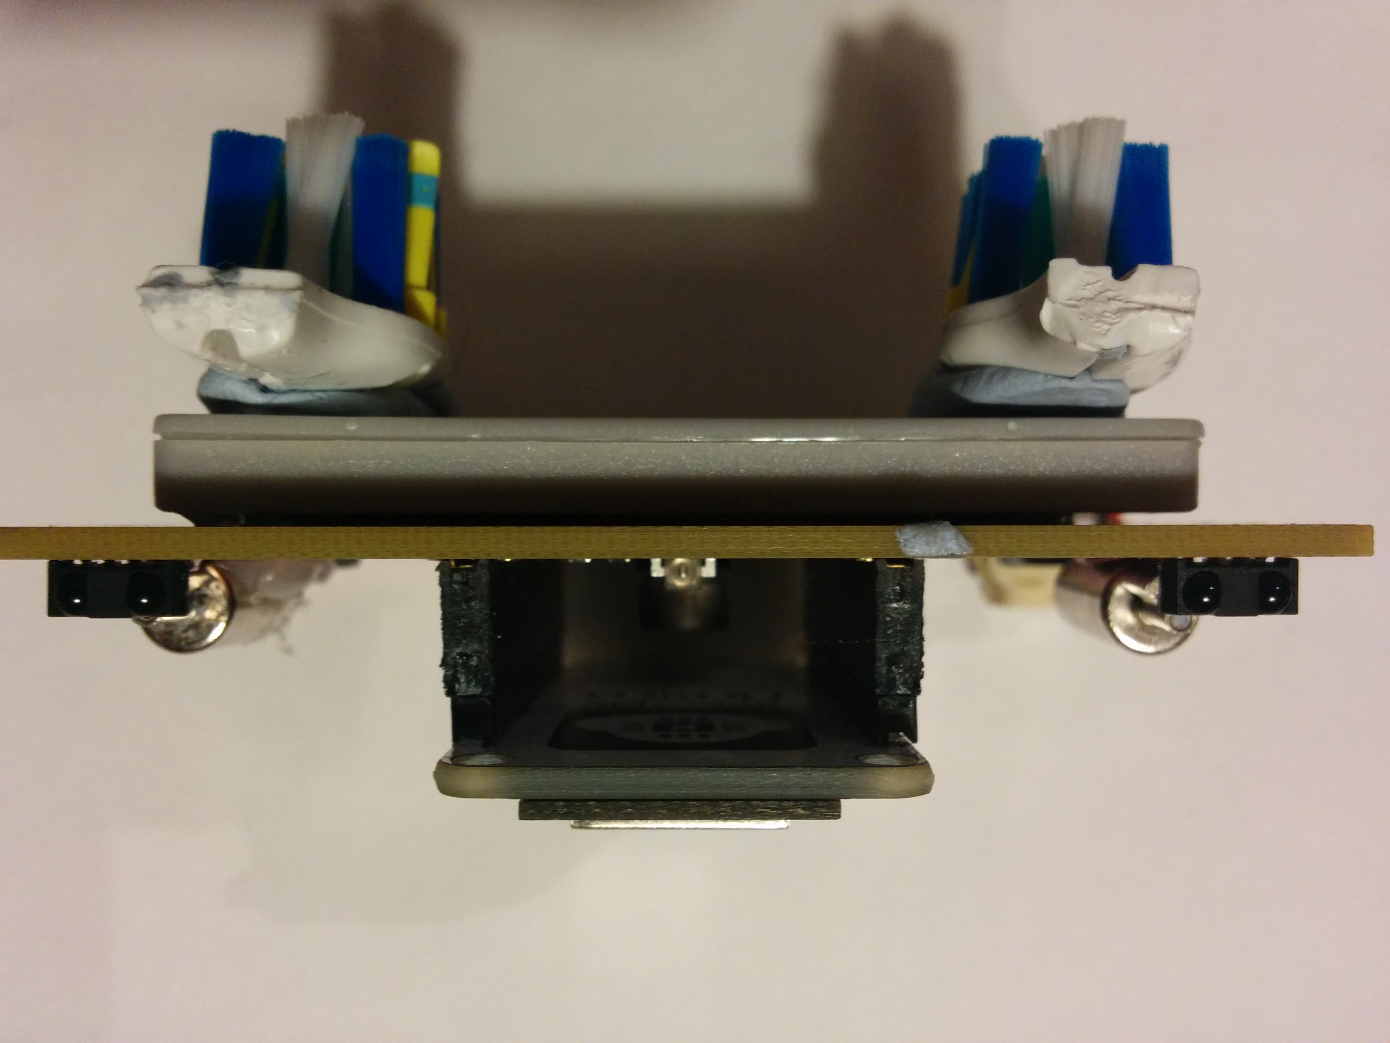
Top/Front View
USB Jack
Reset Switch
Resistor
Battery Connector
Red/Blue LED
Power Switch
Transistor (MOSFET)
VibroMotors
Microprocessor
Blue LED
Capacitor
WiFi Antenna
InfraRed Sensor
Battery
InfraRed Emitter
Tooth Brush Heads

Slide 3
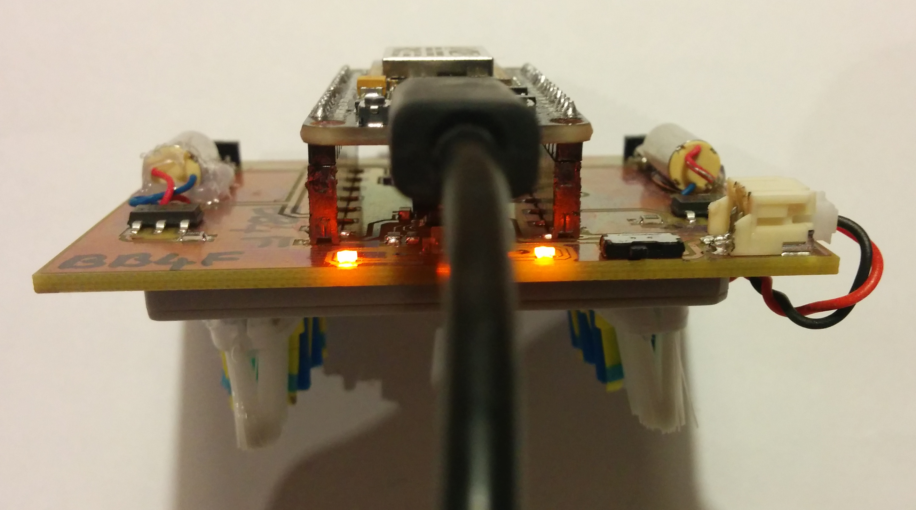
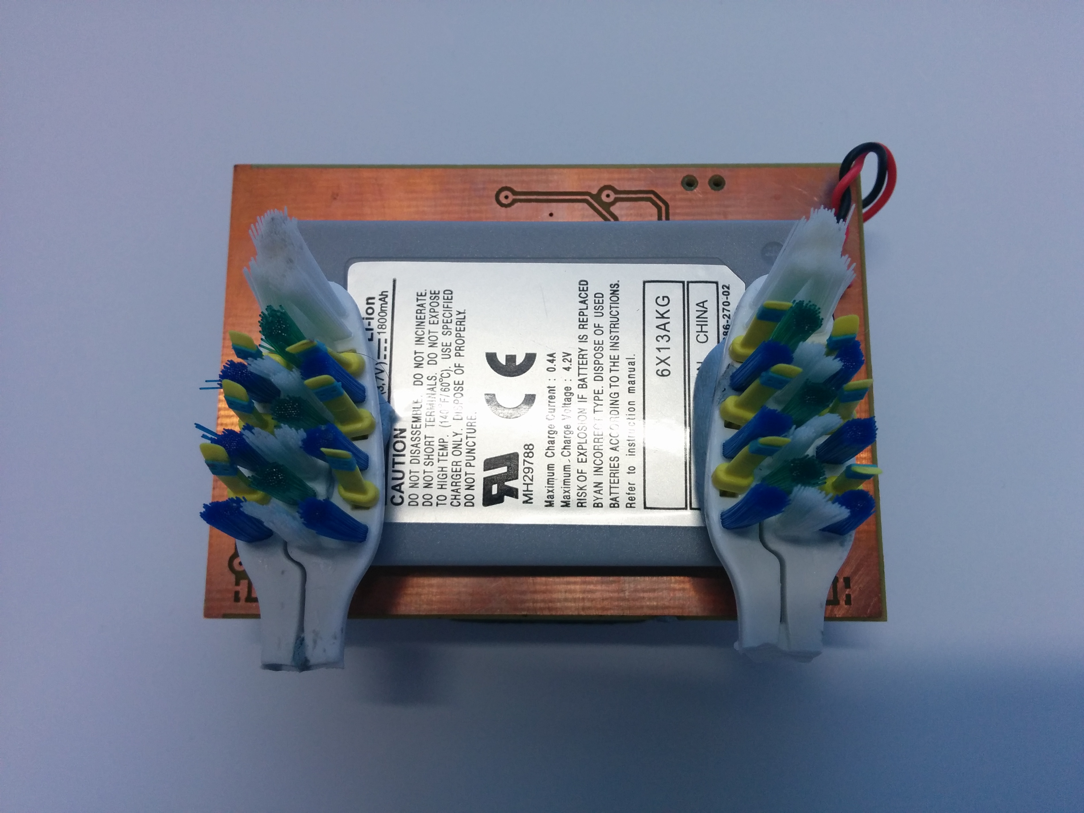
Rear/Bottom View
Battery connector
Micro USB cable
ON
Power Switch
Orange USB battery charging indicator LED
Orange USB Power Indicator LED
Battery
Tooth Brush Heads

